Slide 1

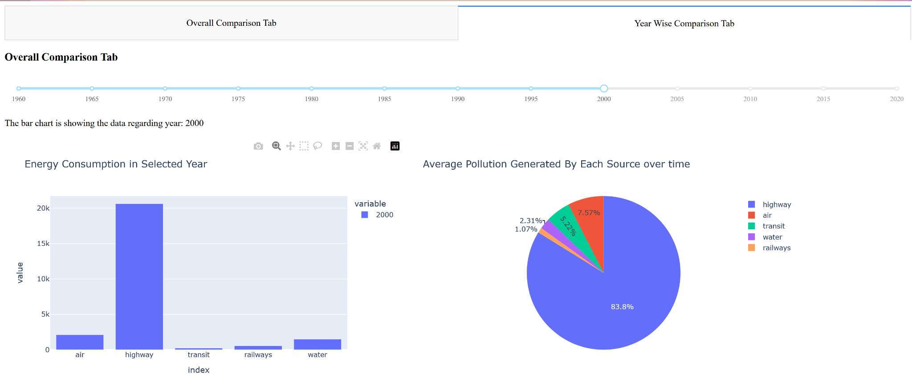
Analysis on Energy Consumption
Mode of Transportations
Giri Manohar Vemula
Gouru Karthikeya Reddy
Mohammad Zaker
Prashanth Krishnamsetty

Slide 2
Overview
Over time, one of the most significant aspects of life that has been put in danger by the current way of life of travel is the pollution that is being produced. They are damaging the environment, and in certain parts of the world, the pollution is turning certain cities inadequate. There are many areas in China, India, and Iran where pollution created by factories and transportation is disrupting everyday life and posing a threat to health that is not limited to producing transient health problems, such as pneumonia or bronchitis. They also include discomforts such as nasal, throat, eye, and skin irritation. Additionally, air pollution can cause headaches, vertigo, and nausea. However, it is also creating an increase in serious diseases such as heart disease, lung cancer, and respiratory diseases, which can have long-term impacts on the residents of these locations.
We chosen the dataset from the U.S. Census data and statistics from The Bureau of Transportation Statistics (BTS) that offers categorical data on Energy Consumption by Mode of Transportation. This information is one of the greatest resources for determining which forms of transportation cause the most pollution in the United States. By analyzing this data, we hope to determine whether we are considering the optimal modes of transportation.

Slide 3
User Stories And Acceptance Criteria
General person
A person who wastes fuel unnecessarily feels guilty about his resource consumption and CO2 emissions and wants to know which mode of transportation is the most economical.
Social Economic person
An individual who is concerned about society wants to know how much energy been consumed by transportation industry and wants to conduct a self-analysis to determine how much pollution future generations will face.
Government
The pollution department intends to collect student-documented analysis reports on energy waste from universities.
The U.S. Department of Energy is concerned with the amount of energy that is turning into pollution in order to reduce the amount used and improve the air quality in U.S. cities.

Slide 4


Tools and Frameworks

Slide 5
Results

Slide 6


